Slide 1


MUSHROOM CLASSIFICATION
FINAL REPORT

Slide 2
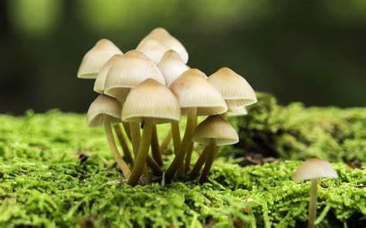
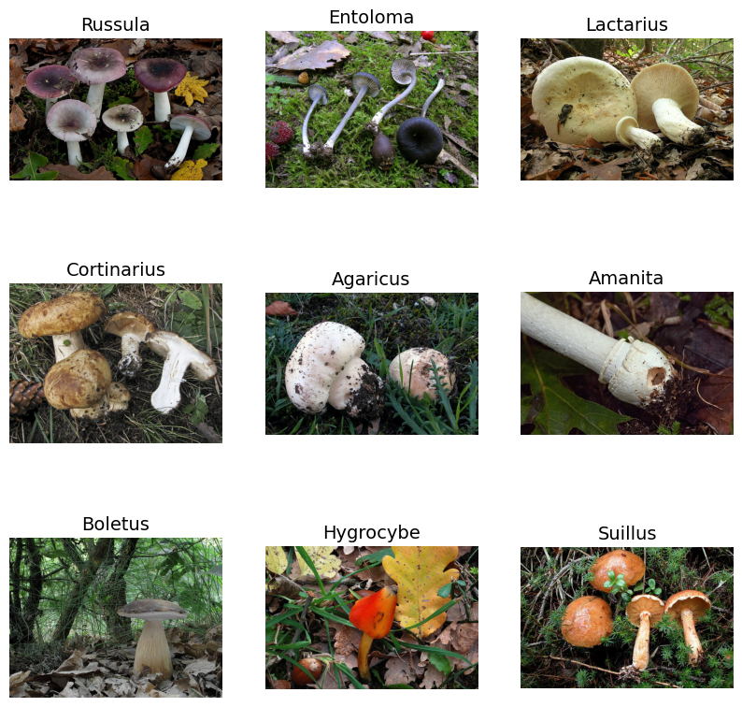
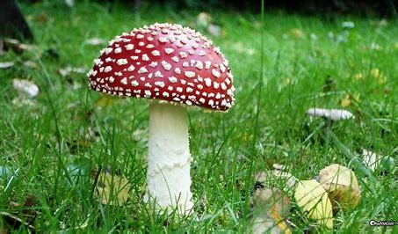
Introduction

Slide 3
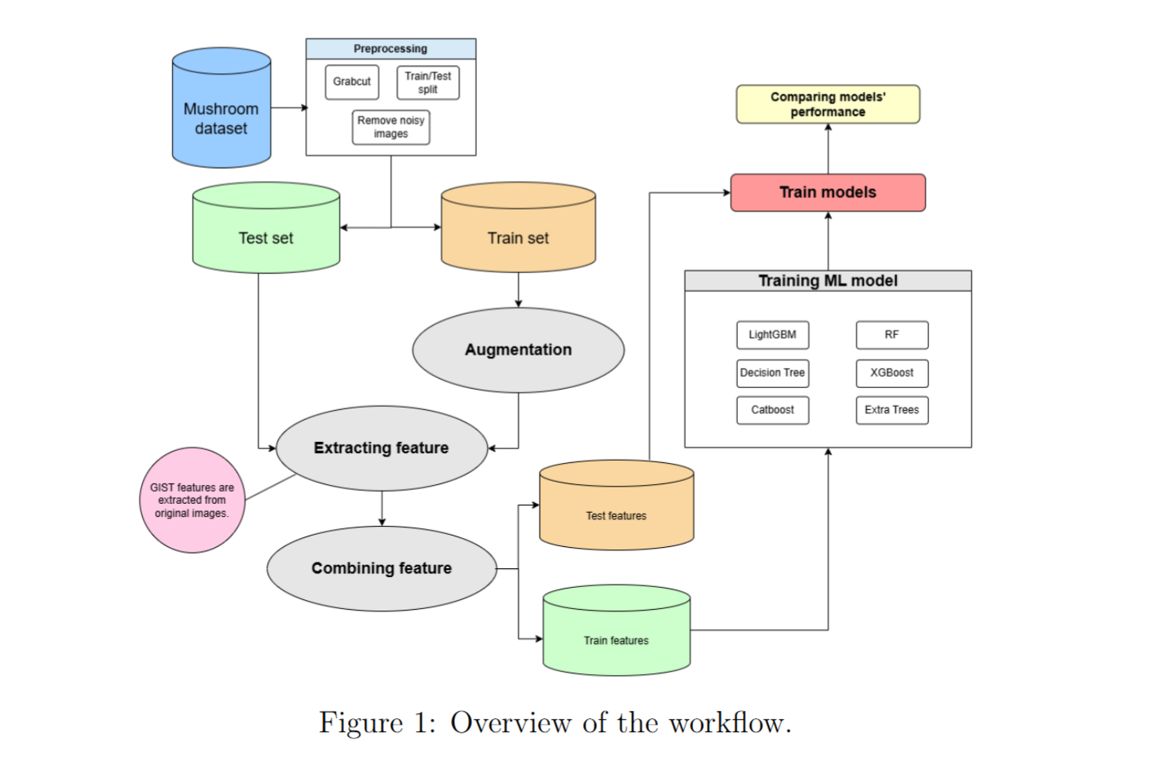
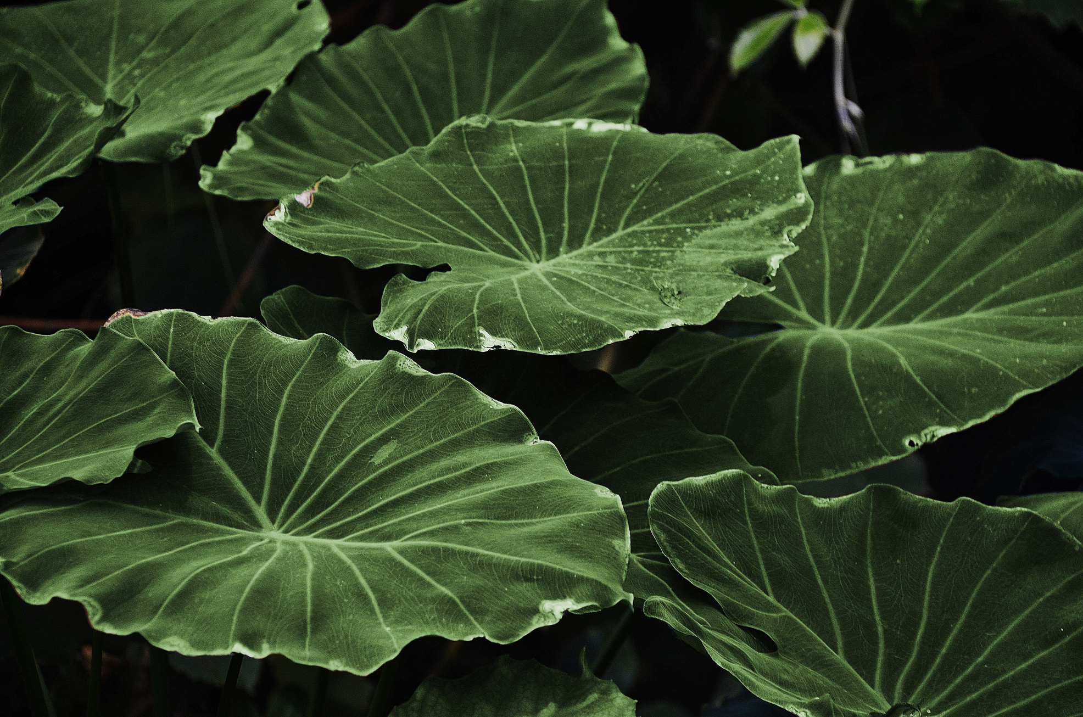
Methodology

Slide 4
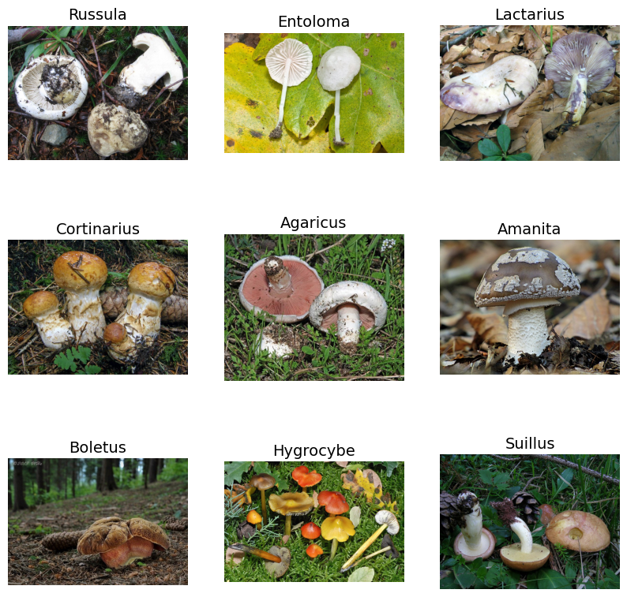
Data description
Common Genus’s Images
6,714 images of the most common Northern European mushroom genera, categorized into nine distinct classes.
The dataset includes between 300 to 1,500 images per class, capturing diverse species and environmental conditions.

Slide 5
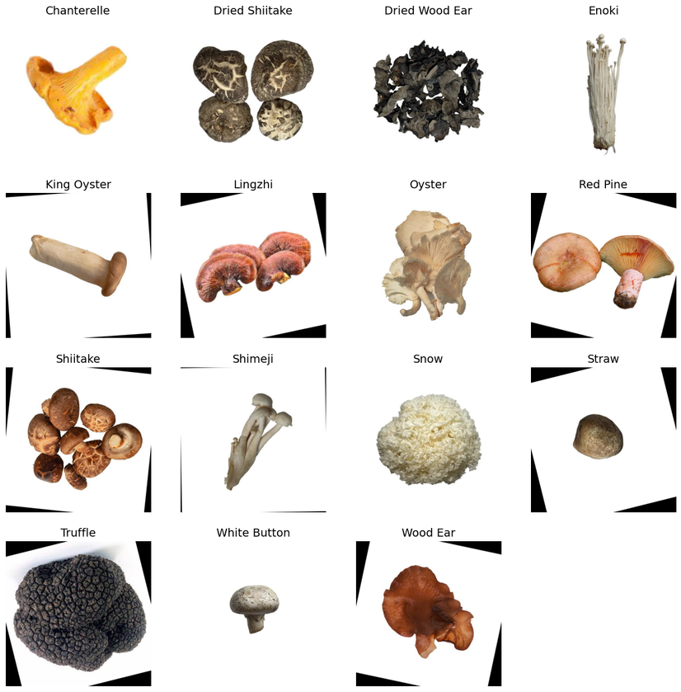
Data description
Klasifikasi Jamur Dataset
The secondary dataset consists of 4,764 images spanning 14 mushroom types.
All images have been preprocessed by the original dataset authors, including background removal, resizing to 640x640 pixels, and augmentation techniques such as rotation and flipping.

Slide 6
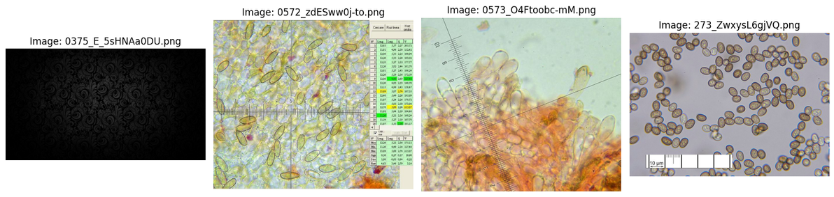
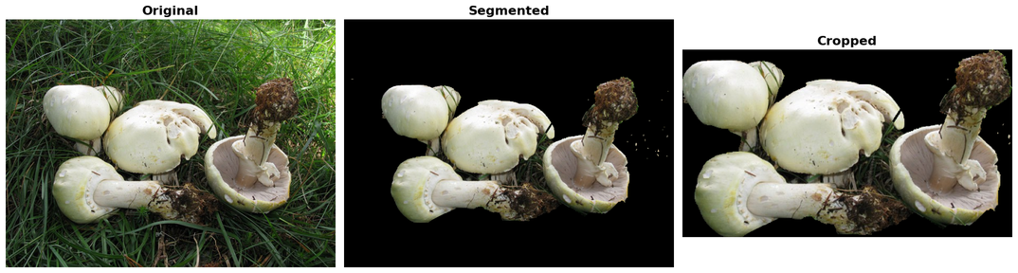
Data preprocessing
Common Genus’s Images
Noise Filtering: Noisy images were filtered out to enhance data quality.
Image Resizing: The mushroom images were resized to reduce computational costs and speed up processing, especially for large datasets.
Foreground Extraction with GrabCut: A bounding box was initialized around the mushroom, and the GrabCut algorithm was applied to effectively separate the mushroom from its background, discarding unnecessary details.
Object Cropping: After background removal, the image was converted to a binary mask to detect the primary object (the mushroom). The largest contour representing the mushroom was used to crop the image, retaining only the significant area for feature extraction and classification.

Slide 7
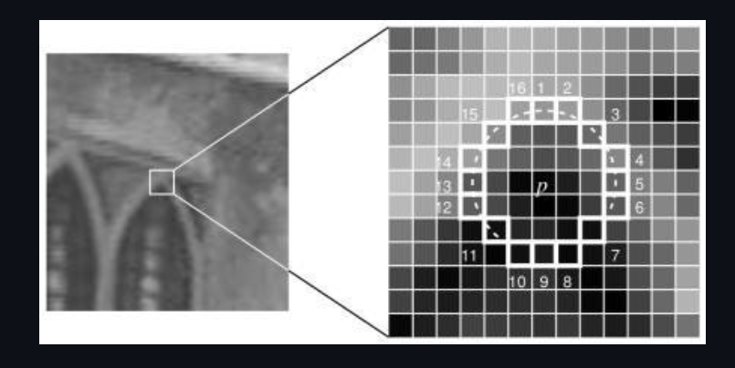
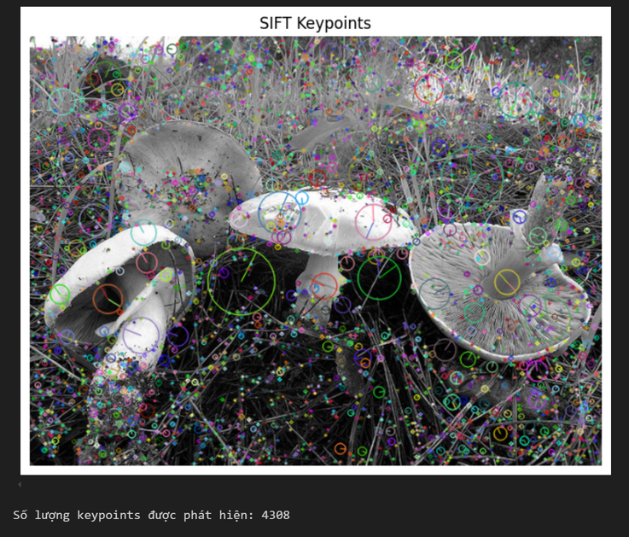
Feature Extraction
SIFT
GIST
Detects and describes stable keypoints across scale and rotation changes, robust for object recognition but computationally intensive.
Extracts global image features using Gabor filters, capturing overall scene structure. Useful for scene recognition and complex image classification.
ORB
A fast, efficient keypoint detector and descriptor, invariant to scale and rotation. It's a cheaper alternative to SIFT, suitable for real-time applications.

Slide 8
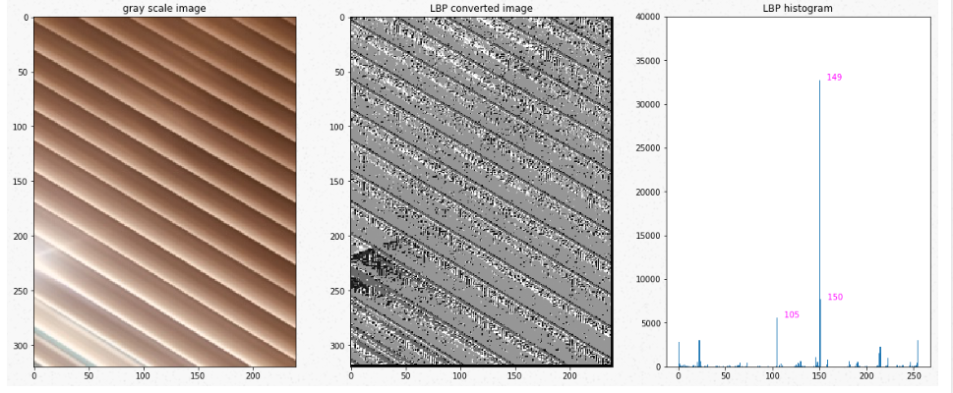
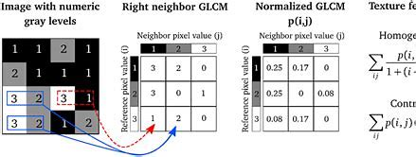
Feature Extraction
COLOR HISTOGRAM
LBP
Analyzes color in the color space, reducing the impact of lighting changes and suitable for color-based classification.
Encodes local texture by comparing the central pixel value with its neighbors, effective for face recognition and surface pattern classification.
GLCM
Analyzes spatial relationships between pixel pairs to extract features like contrast, homogeneity, energy, and correlation. Ideal for texture analysis.

Slide 9
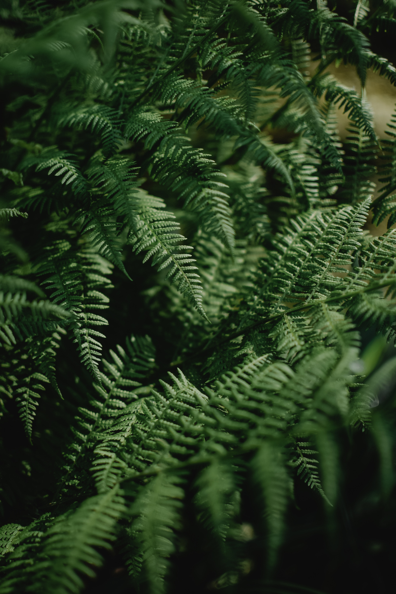
Feature Extraction
HU MOMENT
CONTOUR
Computes shape moments invariant to scaling, translation, and rotation, making it robust for object recognition under varying conditions.
Contours are extracted using Gaussian Blur and Adaptive Thresholding to reduce noise and segment the image. Features like area, perimeter, compactness, aspect ratio, and contour count describe the object's shape, aiding in object recognition.
Color Basics
Using RGB and HSV color spaces, basic color features include the mean, standard deviation, and channel ratios. These features help capture color distribution and differentiate objects based on color differences effectively.

Slide 10
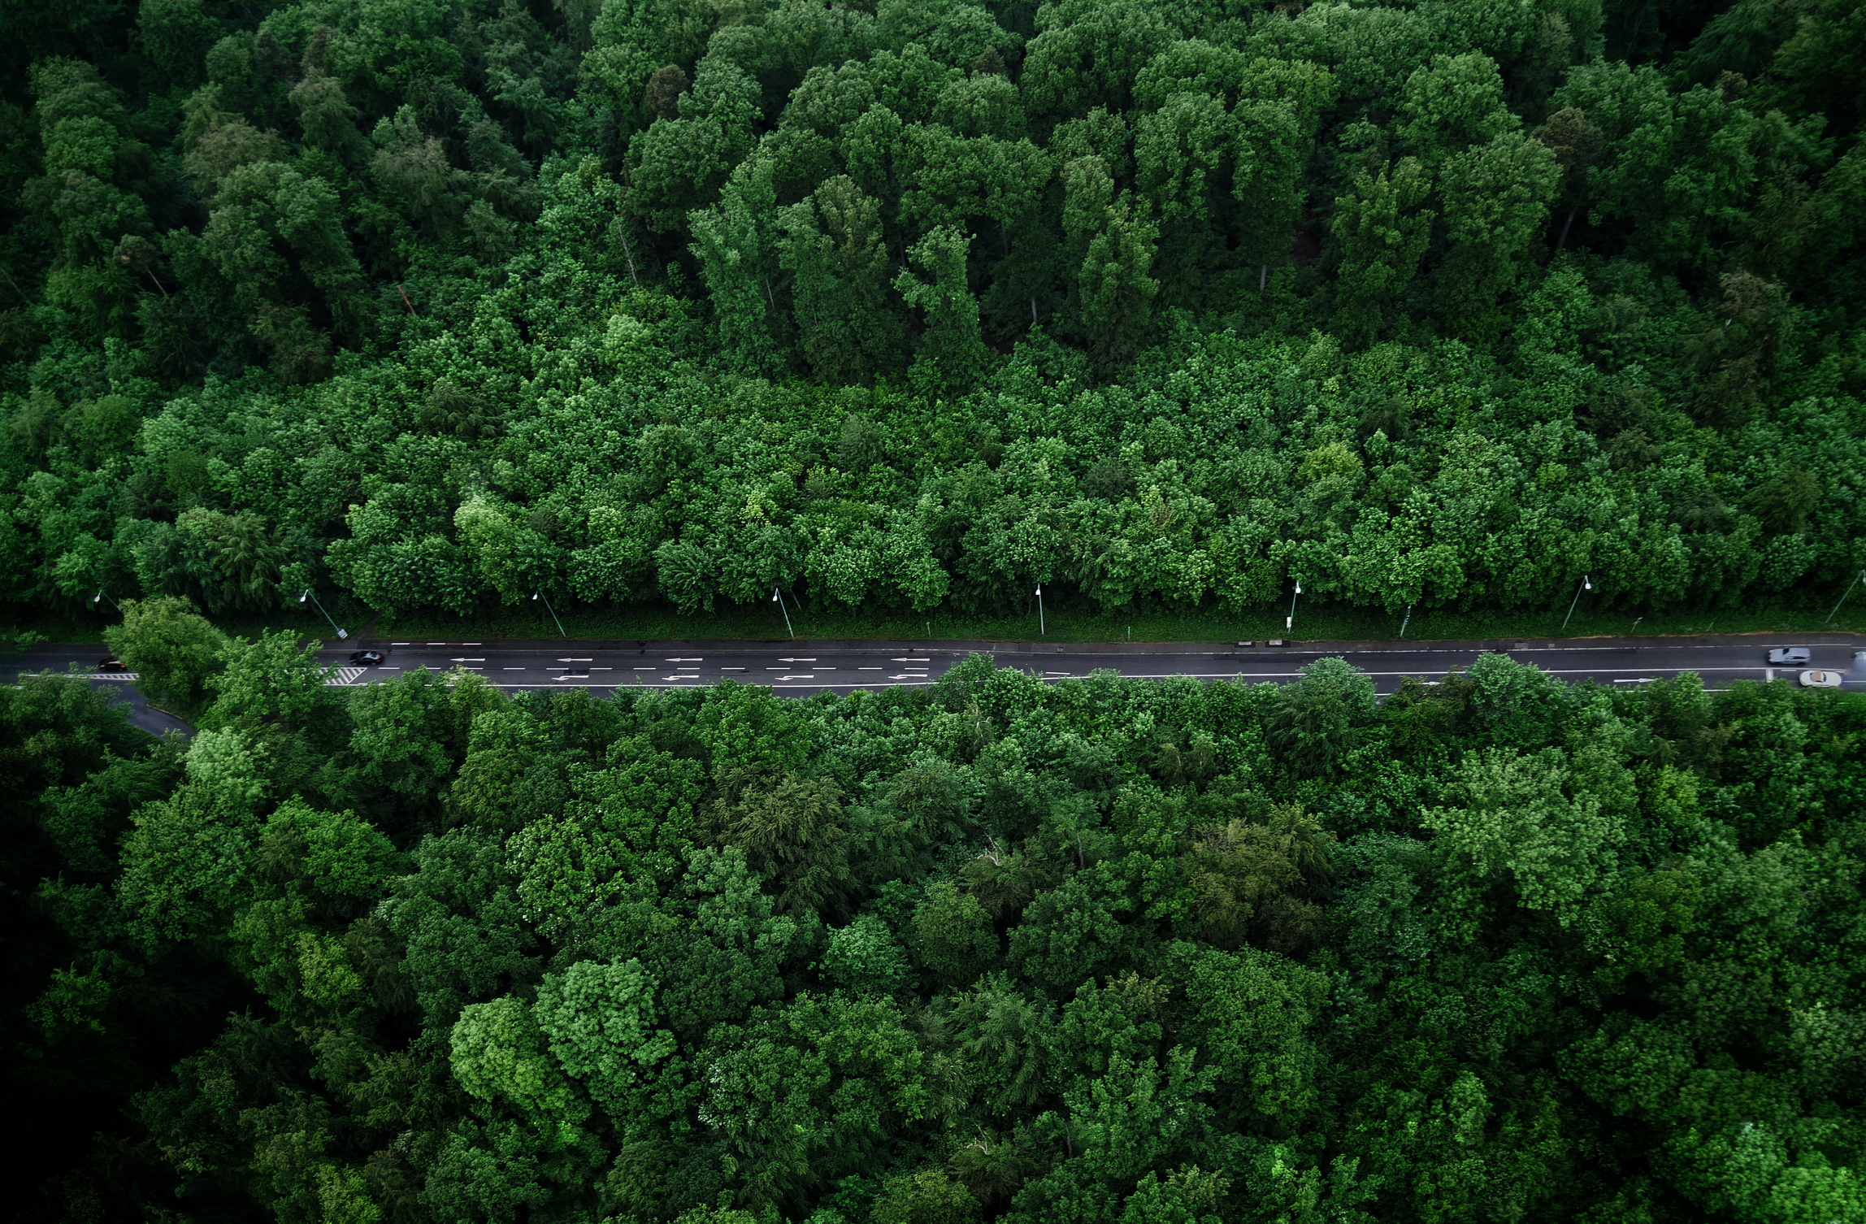
Feature Selection
RANDOM FOREST
Utilizes the Bagging technique to build multiple decision trees on random subsets of the dataset. Feature importance is evaluated using Mean Decrease in Impurity (Gini importance) or Mean Decrease in Accuracy (drop in accuracy when features are shuffled). Features with higher importance scores are selected to reduce dimensionality.
LightGBM
Uses Gradient Boosting with a leaf-wise growth strategy, measuring feature importance through Gain (reduction in loss) and Split Count (number of times a feature is used for splitting). Features with high Gain are prioritized. This method is efficient with large datasets but requires careful hyperparameter tuning.

Slide 11
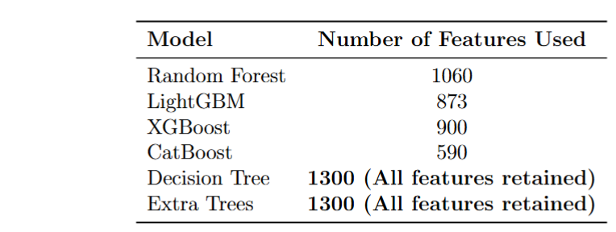
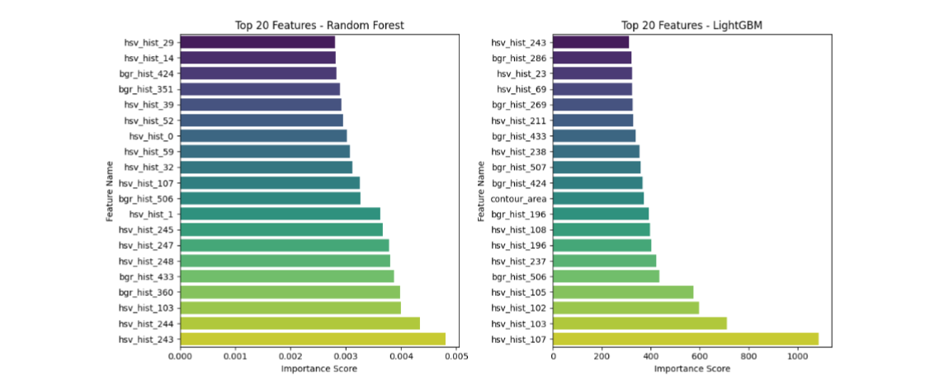
Feature Selection
For the primary dataset, the optimal feature combination consisted of Color histograms, SIFT, LBP, GIST, GLCM, ORB, Hu moments, and Color basic, totaling 1,300 features:
1024 + 128 + 10 + 64 + 20 + 32 + 7 + 15 = 1300

Slide 12
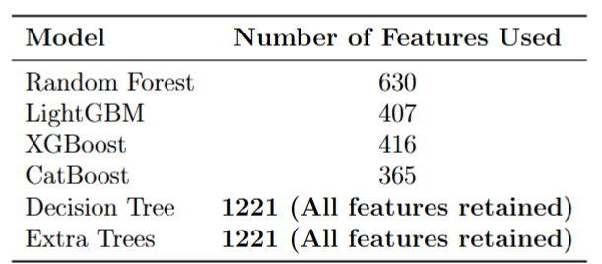
Feature Selection
For the secondary dataset, the optimal feature combination consisted of Color histograms, SIFT, LBP, GLCM, Hu moments, and ORB, totaling 1,221 features:
1024 + 128 + 10 + 20 + 7 + 32 = 1221

Slide 13
Model
LightGBM: Fast, accurate, handles large datasets and missing values well.
Extra Trees: Quick random splitting, good variance reduction.
XGBoost: High performance, strong overfitting control, popular in competitions.
Random Forest: Ensemble of decision trees, reduces overfitting, highly effective.
CatBoost: Handles categorical data well, easy to use, accurate.
Decision Tree: Simple, interpretable, prone to overfitting, useful for basic models.

Slide 14
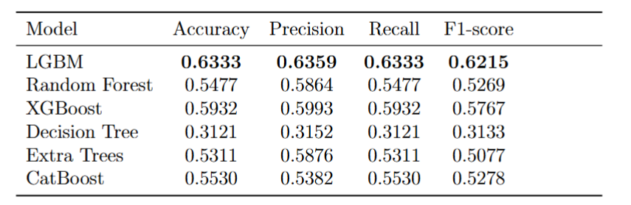
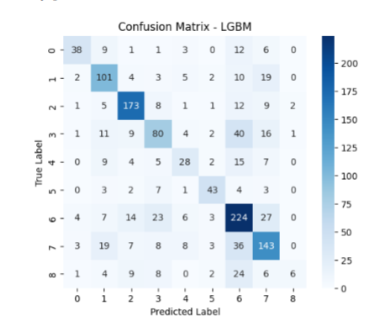
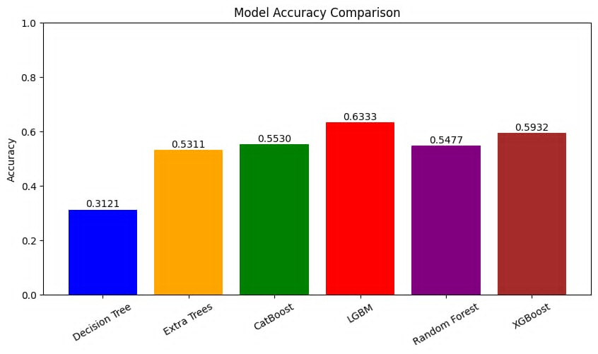
Model Evaluation
Common Genus’s Images

Slide 15
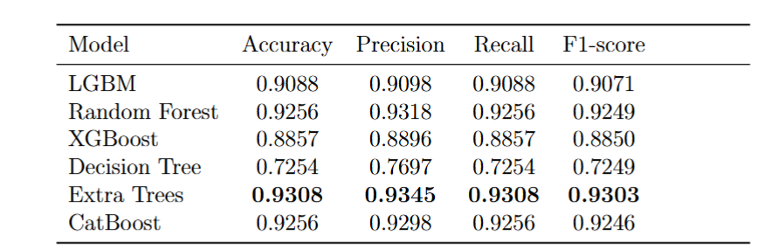
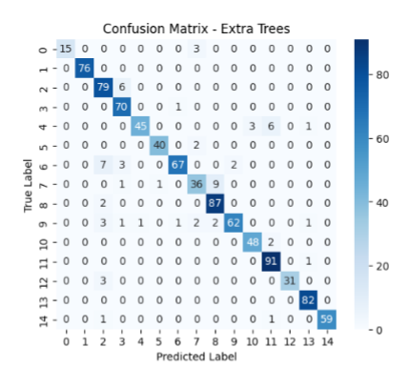
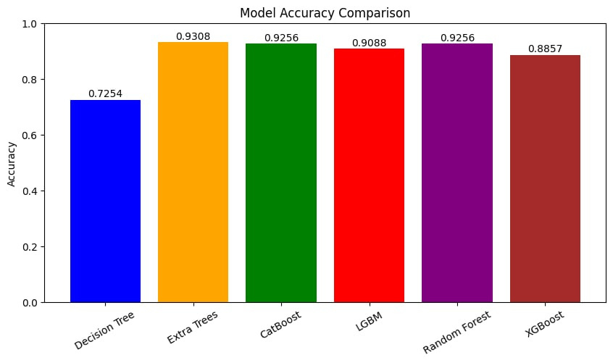
Model Evaluation
Klasifikasi Jamur Dataset

Slide 16
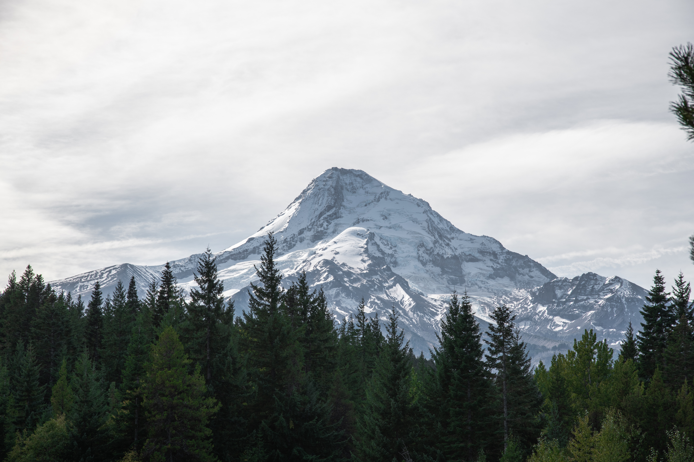
Errors and Adjustments
Errors Encountered: Data leakage occurred due to applying augmentation on both training and test sets. Additionally, labels from the test set were unintention-ally included in training.
Adjustments Made: Augmentation was restricted to only the training set to prevent information from leaking into the test set. The dataset pipeline was revised to ensure no label contamination.
Effect on Results: The original inflated accuracy was corrected after fixing the leakage, leading to more realistic and generalizable model performance.

Slide 17
Comparison and Discussion
Model Performance Comparison
Primary Dataset: LightGBM led with 63.33% accuracy; Decision Tree weakest at 31.21%.
Secondary Dataset: Extra Trees topped at 93.08%; Decision Tree remained lowest.
Key Factors: LightGBM excels with background variability; Extra Trees thrives with cleaner preprocessing.
Dataset Influence
Primary: Less refined background removal favored LightGBM’s robustness.
Secondary: Extensive preprocessing boosted tree-based models like Extra Trees.
Class imbalance skewed predictions toward dominant classes (e.g., Lactarius, Dried Wood Ear).
Challenges
Limited benchmarks, high model complexity, and visual similarity between mushrooms hinder progress.
Summary
LightGBM and Extra Trees outperformed others; preprocessing and class balance are critical for accuracy.

Slide 18


Thank You
FOR YOUR ATTENTION
Discovering Beauty in the Natural World
Only at: www.reallygreatsite.com

